Slide 1

B.Tech 7ᵗʰ Semester Major project presentation
“Intelligent farming Solution”
Presented by:
Parthiv Patel - 210305125009
Prem Malviya - 210305125008
Tushar Sharma - 210305125017
Deep Maheshwari -
Supervisors:
Prolay biswas
PARUL INSTITUTE OF TECHNOLOGY, PARUL UNIVERSITY
NAME OF THE INSTITUTE, PARUL UNIVERSITY

Slide 2
Broad Outline/Background/Problem Statement
With the exponential growth of world population, according to the UN Food and Agriculture Organization, the world will need to produce 70% more food in 2050, shrinking agricultural lands, and depletion of finite natural resources, the need to enhance farm yield has become critical.
Availability of natural resources such as fresh water and arable land along with slowing yield trends in several staple crops, have further aggravated the problem.
Moreover, agricultural labor in most of the countries has declined. As a result of the declining agricultural workforce, adoption of internet connectivity solutions in farming practices has been triggered, to reduce the need for manual labor
NAME OF THE INSTITUTE, PARUL UNIVERSITY
NAME OF THE INSTITUTE, PARUL UNIVERSITY

Slide 3
Introduction
The global agricultural sector is facing immense challenges, including climate change, resource scarcity, and the need for increased food production to meet the demands of a growing population.
The Intelligent Agriculture System is proposed as a solution to modernize farming by integrating cutting-edge technologies such as the Internet of Things (IoT) and machine learning (ML)
IoT in agriculture is revolutionizing farming practices by leveraging technology to enhance efficiency, sustainability, and profitability. By collecting and analyzing real-time data from sensors, farmers can make informed decisions about resource management, pest control, and crop management. This approach, known as precision agriculture, helps bridge the supply-demand gap by ensuring high yields, reducing costs, and protecting the environment.
NAME OF THE INSTITUTE, PARUL UNIVERSITY
NAME OF THE INSTITUTE, PARUL UNIVERSITY

Slide 4
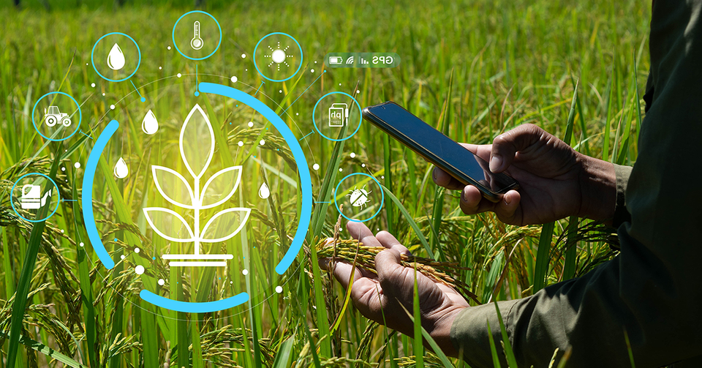
Introduction
IoT in agriculture enables farmers to remotely monitor field conditions and automate tasks based on real-time data, leading to improved efficiency, sustainability, and overall crop management.
NAME OF THE INSTITUTE, PARUL UNIVERSITY
NAME OF THE INSTITUTE, PARUL UNIVERSITY

Slide 5
Aim and Objectives of Study
Smart agriculture centers on managing the supply of land and focusing on the right growing parameters in order to ensure production for the right product that is in demand
provide a better understanding of the development of intelligent agriculture
Implement predictive analytics
improve crop yields and reduce human-wildlife conflicts
Develop an IoT-based infrastructure:
Integrate sensors to monitor soil moisture, temperature, humidity, and light.
Automate irrigation
NAME OF THE INSTITUTE, PARUL UNIVERSITY
NAME OF THE INSTITUTE, PARUL UNIVERSITY

Slide 6
Novelty/Problem Justification
Traditional farming practices face significant limitations, particularly in the areas of resource management and yield optimization. Common problems include
Water Wastage
Fixed Fertilization Schedules
Lack of Real-Time Data
The Intelligent Agriculture System introduces several novel elements to address these challenges:
Efficient Resource Management
Predictive Analytics
Automated Decision-Making
NAME OF THE INSTITUTE, PARUL UNIVERSITY
NAME OF THE INSTITUTE, PARUL UNIVERSITY

Slide 7
Literature Review (if any)
NAME OF THE INSTITUTE, PARUL UNIVERSITY
NAME OF THE INSTITUTE, PARUL UNIVERSITY

Slide 8
Proposed Methodology
NAME OF THE INSTITUTE, PARUL UNIVERSITY
NAME OF THE INSTITUTE, PARUL UNIVERSITY

Slide 9
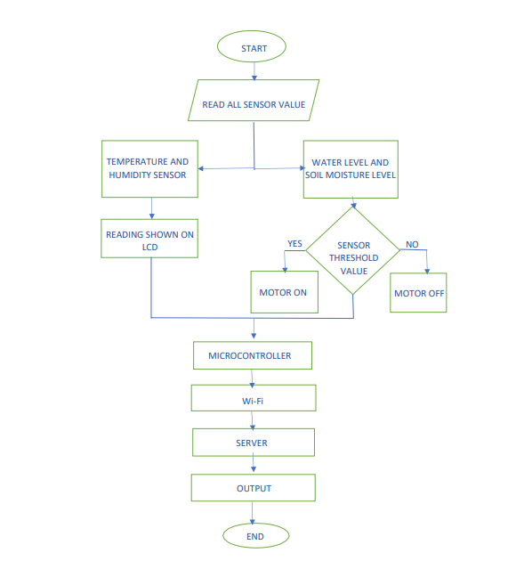
DFD / ER DIAGRM
NAME OF THE INSTITUTE, PARUL UNIVERSITY
NAME OF THE INSTITUTE, PARUL UNIVERSITY

Slide 10
Hardware & Software Detail
Software Detail
Front End:
Back End:
Hardware Detail
Arduino IDE
DHT22 Sensor
Adafruit Libraries
Soil Moisture Sensor
Adafruit_GFX.h
LCD Display (Nokia 5110)
Adafruit_PCD8544.h
Arduino :
DHT Library
JSON for Data Transfer
ArduinoJson library
NAME OF THE INSTITUTE, PARUL UNIVERSITY
NAME OF THE INSTITUTE, PARUL UNIVERSITY

Slide 11
Work Plan/Time line
NAME OF THE INSTITUTE, PARUL UNIVERSITY
NAME OF THE INSTITUTE, PARUL UNIVERSITY

Slide 12
Approximate Budget (if any)
NAME OF THE INSTITUTE, PARUL UNIVERSITY
NAME OF THE INSTITUTE, PARUL UNIVERSITY

Slide 13
GUI
NAME OF THE INSTITUTE, PARUL UNIVERSITY
NAME OF THE INSTITUTE, PARUL UNIVERSITY

Slide 14
Future Scope
NAME OF THE INSTITUTE, PARUL UNIVERSITY
NAME OF THE INSTITUTE, PARUL UNIVERSITY

Slide 15
Prons & Cons
Prons:
Remote monitoring: Farmers can monitor their fields remotely, ensuring timely intervention and reducing the need for physical presence.
Enhanced decision-making: ML algorithms can analyze vast datasets from IoT sensors to provide actionable insights, helping farmers optimize resource allocation, predict crop yields, and detect diseases early.
Cons:
Technical expertise: Managing IoT systems and ML models requires technical expertise, which may be a barrier for some farmers.
Internet connectivity: Reliable internet connectivity is essential for IoT-based agriculture, and challenges may arise in remote or rural areas.
NAME OF THE INSTITUTE, PARUL UNIVERSITY
NAME OF THE INSTITUTE, PARUL UNIVERSITY

Slide 16
Conclusion
The Intelligent Agriculture System offers a modern solution to the challenges faced by traditional farming. By leveraging the power of IoT and machine learning, this innovative system offers enhanced crop yield, improved resource management, and sustainable farming practices. the system enhances crop yield, improves resource management, and promotes sustainable farming practices, Through real-time insights, predictive analytics, and automation, farmers can make data-driven decisions and achieve greater efficiency in their operations.
This intelligent system provides real-time insights, predictive analytics, and automation to help farmers make data-driven decisions and achieve greater efficiency in their operations. This technology-driven approach has the potential to revolutionize the agricultural industry and ensure a more sustainable future for food production.
NAME OF THE INSTITUTE, PARUL UNIVERSITY
NAME OF THE INSTITUTE, PARUL UNIVERSITY

Slide 17
References
NAME OF THE INSTITUTE, PARUL UNIVERSITY
NAME OF THE INSTITUTE, PARUL UNIVERSITY

